Slide 1




Team no: MBH-01
Team Members:
Pankaj Diwan- ECE 4-2
Baradwaj- EEE 3-2
Kartikey- CSE 2-2
Sai Akshay- IT 1-2

Slide 2
Problem Statement
Method for tracking of transactions made in cash, showing more expenditure, maintaining two ledgers, puting personal expenditure in bussiness,Providing false Identity PAN details Etc.

Slide 3
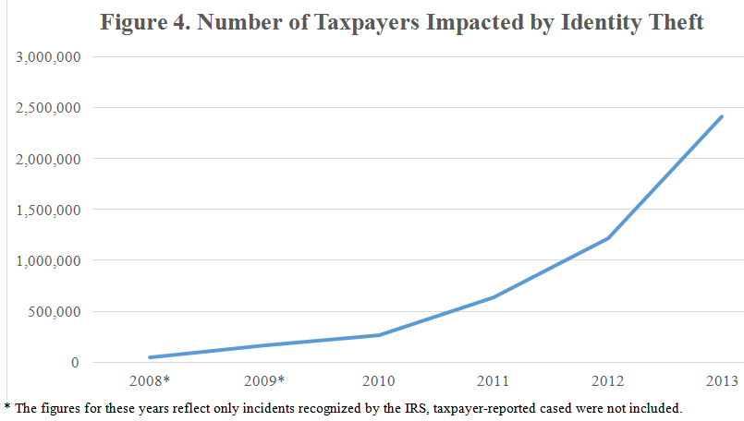
Statistics
The latest IRS figures show that there were 2.4 million taxpayers impacted by identity theft in 2013.

Slide 4
Present Scenario
Manual Verification of the documents by the Human interface
Process for only online transactions.

Slide 5
Proposed Solution
Online transactions with Tracking of currency notes ID.
Property check with Ownership and realted details.
Algorithm calculates the tax with standard values.

Slide 6
Stake Holders
Funds Department
Government officers

Slide 7
Smart Contract
Registration of Tax Payer by Officer
Store and Calculate the Tax to be paid
Payment with due Alert every month

Slide 8
References
→ https://www.washingtonpost.com/world/asia_pacific/indias-huge-need-for-electricity-is-a-problem-for-the- planet/2015/11/06/a9e004e6-622d-11e5-8475-781cc9851652_story.html?noredirect=on&utmterm=.65256086f568

Slide 9
Thank You
Team no: MBH-01

